Slide 1
The MAMI Project and the NFV Way to Internet Path Transparency
Diego R. López, Telefónica I+D

Slide 2
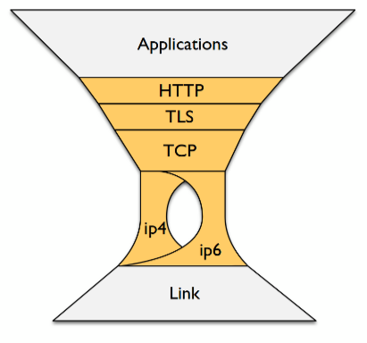
The Ossified Internet
All applications forced to use the same transport combination
HTTP (on TLS) on TCP
In despite of the many known limitations
A couple of main technical reasons
Inflexible development interfaces
The effect of middlebox impairments
Limit the deployability of any new solution

Slide 3
Middleboxes and Impairments
Middleboxes make restrictive, implicit assumptions about traffic
Dropping or altering unknown flows
But middleboxes are essential components of almost any conceivable network service
Access control
Optimization
Security
Accounting
<Your favorite function here>
Anyway, the old Internet end-to-end ambition does not apply in a network of clouds and pervasive IoT

Slide 4
What We Are Talking About
Path transparency: the likelihood a packet stream that arrives at the end of the path is the one that was sent with certain properties.
Impairment: something that keeps a path from being transparent for a certain kind of traffic, dependent on that traffic’s properties.
Blocked connections, 100% packet loss
Increased drop rate, increased latency
Bleaching: removal or rewrite of necessary headers
B2B proxying: replacing one e2e path with two

Slide 5



The MAMI Project
Measurement and Architecture for a Middleboxed Internet
of deployed middleboxes
for middlebox cooperation
of use case applicability and deployability
More data about the nature and distribution of middlebox impairments
Common data model for storage and analysis
Explicit middlebox cooperation to declare assumptions and intentions independent of the used transport or higher-layer protocol
New transport encapsulation + in-band signaling
Relying on the FIRE infrastructure for measurement as well as experimentation
Especially on mobile access networks
Strong interaction with relevant standards organizations for impact on deployment

Slide 6
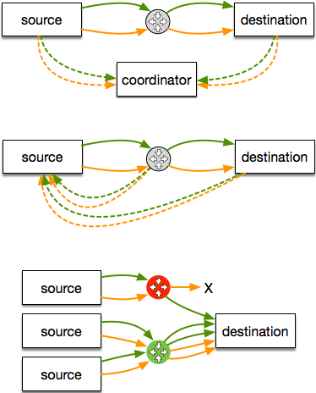
Active Measurement
Throw a bunch of packets with certain properties at the Internet, and see what happens
Ideal: two-ended A/B testing
More scalable: one-ended A/B testing
Comparison with topology to isolate on-path vs near-endpoint impairments
Observations from platform- and application-level logs of failed attempts to use protocol features also useful
Integrate heterogeneous observations from many campaigns for better insight
Build an observatory for this integration

Slide 7
The Path Transparency Observatory
Large-scale measurements of path impairments
Using FIRE MONROE as well as RIPE Atlas, CAIDA Ark…
UDP/TCP/SCTP connectivity
TCP options (e.g. TFO, MPTCP)
Other protocols
Development of new measurements tools https://github.com/mami-project/
Path Transparency Observatory
Active measurements by the project + external measurements
A query interface to access observations on path impairments:
active A/B test
(PathSpider)
observations
{t,p,c,v}
traceroute
preanalysis
preanalysis
looking glass
mod trace
(tracebox)
etc.

Slide 8
Why Explicit Middlebox Cooperation?
Deployment problems of new protocols and protocol extension due to ossification in the Internet, e.g.
Multipath TCP
QUIC (over UDP)
Operation and management of in-network functionality hindered due to increasing deployment of encryption, e.g.
Firewalls using port mapping or DPI
Performance enhancements in mobile networks

Slide 9
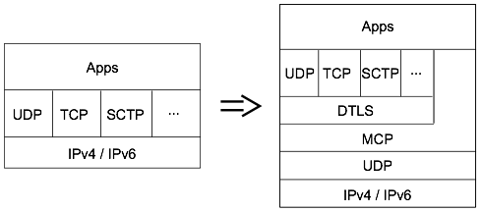
An Explicit Path Interface
Application can directly indicate requirements to path layer
Transport can use the path layer to expose parts of its functionality/intentions to the network
The Middlebox Cooperation Protocol (MCP) signals these information appropriately to on-path middleboxes
Minimizing the information exposed

Slide 10
The Trust Issue
Why should I trust what you say about your flows?
By default, a trust-but-verify policy
Declarative signaling: no negotiation, no guarantees
The best way to prevent cheating is to make it useless to do so
Minimize the information exposed
Explicit trust relationships for higher-assurance declarations
Multi-party security with explicit trust: EFGH, mcTLS

Slide 11
The Standardization Front
Two related proposals discussed at IETF96 in Berlin
PLUS (Path Layer UDP Substrate), “A transport-independent method to signal flow semantics under transport and application control”
Not chartered, mostly because of emotional arguments
Work in progress
LURK (Limited Use of Remote Keys), “Scheduled with the objective of discussing approaches to mitigating security risks to TLS private keys”
Exploring the applicability of temporary certificates via the ACME interfaces

Slide 12
So What About NFV? Well, all middleboxes will become VNFs sooner than later…
Flexible, scalable, on-demand measurement infrastructures
More complete datasets
Path layer implemented in dedicated components
Adaptable VNFs according to MCP declarations
Verification mechanisms by data analytics
Multi-party security support
The NFV approach eases incremental deployment
Stay tuned…

Slide 13
More MAMI at
https://mami-project.eu/

